Slide 1

HOW TO Code Like A Pro
By Kieran.js
Notes:
Hello! My name is Kieran and I will be hosting this how to.
This session basically aims to teach you a bit of advanced javascript concepts as well

Slide 2

Intro - A bit about me
DIT Year 2 Student (Software track)
Loves programming
Javascript is love, Javascript is life
Notes:
This is a bit about me, I’m a year 2 student from DIT.
So why did I choose to host this session?

Slide 3
Why this how to session?
For FOP assignment, my project code was very long, ugly, inefficient,
unorganized and prone to errors.
Whole program squeezed into 1 file (> 1000 lines)
Benefits of session:
Shorten code (significantly!)
Increase efficiency
Increase speed & productivity
Makes programming more fun
Makes code more aesthetic
Notes:
Why did I choose to host this how to session? Back then when I was doing my FOP assignment, I only realized after a while that my program overall was very disorganized, and my code was very unnecessarily long, with over 1000 lines including some hardcoded text and strings, and I also noticed that the long and disorganized code make my program very prone to errors and it makes it difficult to debug because it’s very hard to find which segment of the code is causing the problem and therefore made life difficult.
So these are the benefits of the session which I hope you can takeaway,

Slide 4
Table of Content
1) Template literals ⭐ (No more string concatenation)
2) Guard clauses
3) Truthy & Falsy
4) Ternary Operator ⭐ (Short if-else statement)
5) Spread Syntax
6) Array Descturcturing
7) Object Desctructuring
8) Arrow Functions
9) Array Methods ⭐ (Sweet with arrow functions!)

Slide 5
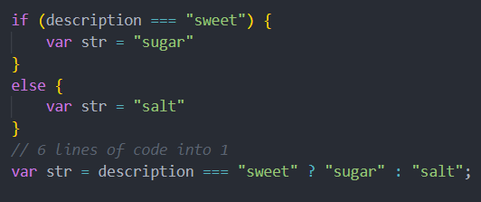
Power & Beauty of… Syntactic Sugar
Notes:
Introducing you to a term called Syntactic Sugar, can anyone guess, what does syntactic sugar mean?

Slide 6
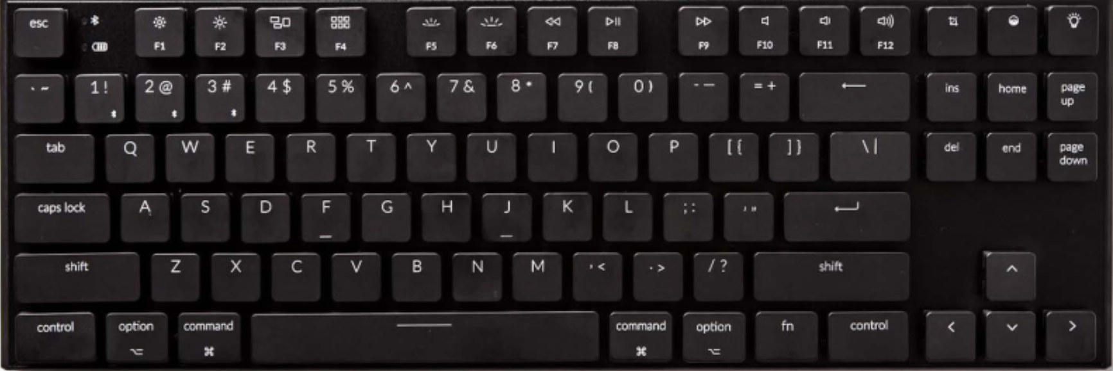

Template Literals (``)
Easy & Modern way of string concatenation
Denoted and wrapped with backtick (`)
Notes:
First thing I want to introduce is template literals, this may sound very advanced but it’s actually not

Slide 7

Template Literals (Example)
Use ${} to put variables inside the template string
const str = “World”;
const stringConcat = “Hello ” + str;
const templateLiteral = `Hello ${str}`
Output: Hello World
// Use template literals instead of string concatenation
Read more at https://developer.mozilla.org/en-US/docs/Web/JavaScript/Reference/Template_literals

Slide 8
Guard Clauses
Used in functions
Makes functional code much cleaner
By removing the else keyword when programming
Makes use of the return statement
Examples from internet: https://refactoring.com/catalog/replaceNestedConditionalWithGuardClauses.html

Slide 9
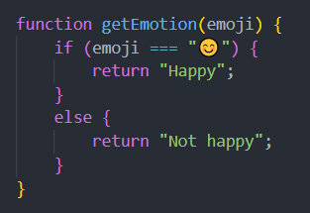
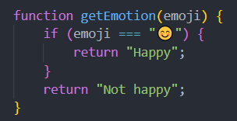
Guard Clause (Example)
Without guard clause
With guard clause
Returning exits function; else is not needed here

Slide 10
Truthy & Falsy Values
Good to know
When encountered in a Boolean Context
Falsy values will be coerced (coverted) to false
Truthy values will be coerced to true
Boolean context is basically where conditions are written
if (condition)
while (condition)
Read more at https://developer.mozilla.org/en-US/docs/Glossary/Truthy

Slide 11
Truthy & Falsy Values
Falsy values:
false
0
empty string (“”)
null
undefined
NaN
Truthy values:
true
All values that are not falsy

Slide 12
Truthy & Falsy Values (Example)
If (0) { console.log(“zero”); }
else { console.log(“one”); }
“one” gets printed out because 0 is a falsy value

Slide 13
Truthy & Falsy Values (Example)
If ([]) { console.log(“teuroo”); }
else { console.log(“phalse”); }
“teuroo” gets printed out because an array is a truthy value

Slide 14
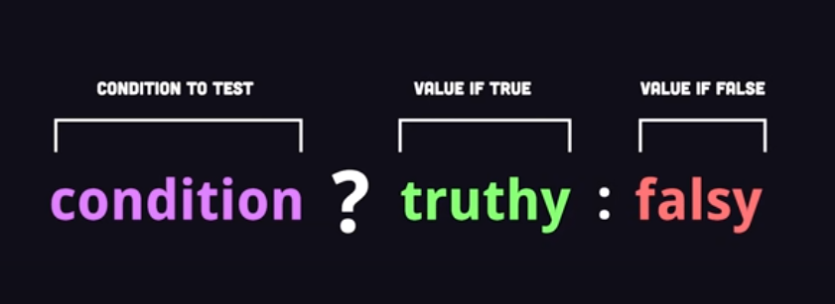
Ternary Operator (?)
If-else statement in 1 line
age >= 21 ? “adult” : “child”
I totally did not steal this image from youtube XD

Slide 15
Ternary Operator (?)
Can be chained (if, else if, else if...)
Evaluates to an expression
Can be used in
Function arguments
Arrays/Object literals
Anywhere that a value/expression is expected
Read more at https://developer.mozilla.org/en-US/docs/Web/JavaScript/Reference/Operators/Conditional_Operator

Slide 16
Spread Syntax (…)
Denoted by 3 dots (…)
Expands an iterable (array/string)
Basically splits up an iterable and gives all individual elements
Simply think of it as spreading over the value’s characters/elements

Slide 17
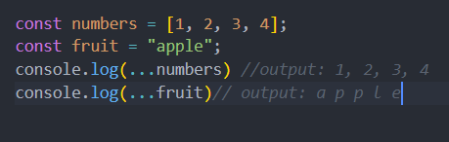
Spread Syntax (Example)
const numbers = [1, 2, 3, 4];
const fruit = “apple”;
console.log(…numbers) //output: 1, 2, 3, 4
console.log(…fruit)// output: a p p l e
Make a new copy of an array:
const numbersCopy = [...numbers] // much shorter than using splice or for loop
Adding multiple items:
const oneToNine = [0, …numbers, 5, 6, 7, 8, 9]

Slide 18
Array Destructuring
Unpack values from an array
Store them into variables
Removes the need for array[index] where suitable
Removes unnecessary and verbose lines
One liner for retrieving array elements

Slide 19
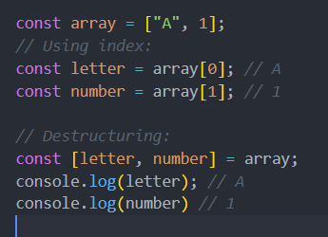
Array Destructuring (Example)
const array = [“A”, 1];
Using index:
const letter = array[0]; // A
const number = array[1]; // 1
Destructuring:
const [letter, number] = array;
console.log(letter); // A
console.log(number) // 1

Slide 20
Object Destructuring
Unpack values from an object
Store them into variables
Removes the need for repetitive typing of object.property/object[property]
One liner for retrieving object property values

Slide 21
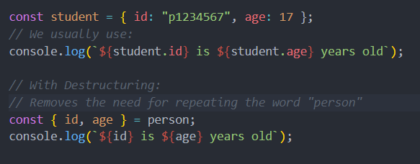
Object Destructuring (Example)
const student = { id: “p1234567”, age: 17 };
We usually use:
console.log(`${student.id} is ${student.age} years old`);
With Destructuring:
Removes the need for repeating the word “person”
const { id, age } = person;
console.log(`${id} is ${age} years old`);

Slide 22
Function Expressions
Functions are one of the most used features of javascript
Different way of function declaration
Function expressions are functions where the name can be omitted to create anonymous functions
Read more at https://developer.mozilla.org/en-US/docs/Web/JavaScript/Reference/Operators/function

Slide 23
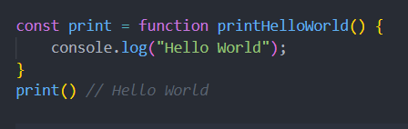
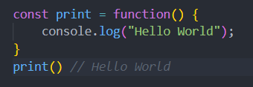
Function Expressions (Example)
Named
Not named

Slide 24
Arrow Functions
Same as normal functions with slight differences
Create new way of function declaration (uses => instead of function)
Can be reduced into 1 line
Does not bind the this keyword
Read more at https://developer.mozilla.org/en-US/docs/Web/JavaScript/Reference/Functions/Arrow_functions

Slide 25
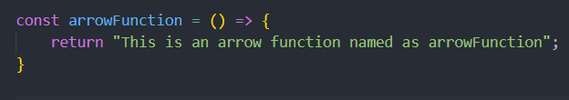
Arrow Functions
Assign arrow function to variable
In one line:

Slide 26
Array Methods
In-built array methods that can help you reduce lines of code
Omit the need to write for loops
Methods covered:
Map
Filter
Reduce

